Slide 2
CONTENTS: 1. HIMALAYAS 2.KARAKORAM RANGES 3.PURVACHAL HILL RANGES
2.THE NORTHERN HIMALAYAS

Slide 3
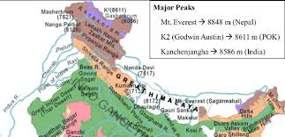
Highest peaks

Slide 4
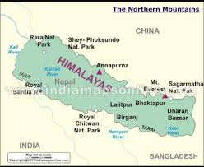

Slide 5
THE GREATER HIMALAYA (HIMADRI) THE MIDDLE HIMALAYA (HIMACHAL) THE OUTER HIMALAYA (SHIWALIK)
HIMALAYAS
THREE PARALLEL RANGES

Slide 6
Chapter 2/social/karunambigai/Sns Academy
THE GREATER HIMALAYAS
HIGHEST OF ALL RANGES
GLACIERS ARE FOUND IN THESE MOUNTAINS
RIVERS – INDUS,GANGA.,YAMUNA AND BRAHMAPUTRA
KANCHENJUNGA – HIGHEST PEAK IN THIS RANGE

Slide 7
LOWER IN HEIGHT THICK FORESTS OF PINE,DEODAR AND FIR HILL STATIONS - SHIMLA,NAINITAL AND DARJEELING
THE MIDDLE HIMALAYAS

Slide 8
SOUTH OF THE MIDDLE HIMALAYA. LOWEST IN HEIGHT. COVERED WITH FORESTS AND WILD ANIMALS.
THE OUTER HIMALAYAS

Slide 9
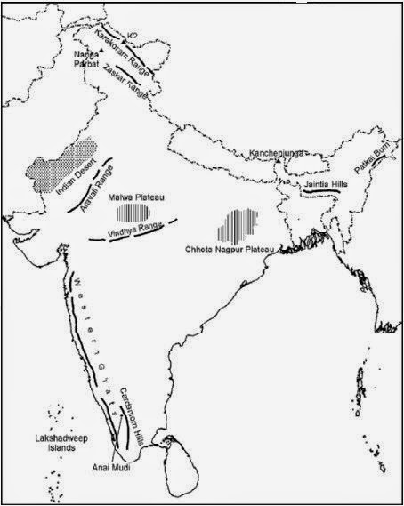
NORTH-WEST OF HIMALAYAS. MOUNT GODWIN AUSTEN (K2) HIGHEST PEAK SECOND HIGHEST PEAK IN THE WORLD.
Karakoram mountains

Slide 10
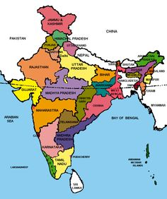
JAMMU AND KASHMIR HIMACHAL PRADESH UTTARAKHAND SIKKIM DARJEELING (WEST BENGAL)
STATES IN THE REGION(KARAKORAM RANGE)

Slide 11
MAIN OCCUPATION – FARMING, SHEEP REARING AND WOOD CARVING
LIFE INTHE REGION

Slide 12
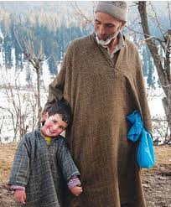
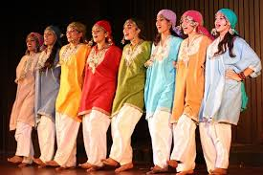
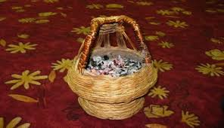
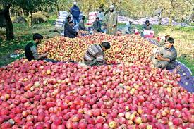
STATES | FAMOUS FRUITS | DRESS | DRINKS | TOURIST PLACES
JAMMU AND KASHMIR | APPLES ORCHARDS AND SAFFRON | SALWAR,PHIRAN | KAHWA, KANGRI POT | SRINAGAR.AMARNATH,LADAKH
HIMACHAL PRADESH | APPLES ORCHARDS | KULLU CAPS,DHAZU | -- | SHIMLA.DALHOUSIE AND MANALI
UTTARAKHAND | BASMATI RICE,LYCHEES AND PALMS | WOOLLEN SHAWLS,SCARVES AND RUGS | - | MUSSOORIE,NAINITAL AND HARIDWAR
SIKKIM | ORANGES,CARDAMON AND ORCHIDS | BAKHU | - | GANGTOK AND PELLING

Slide 13
ARUNACHAL PRADESH NAGALAND MANIPUR MIZORAM TRIPURA MEGHALAYA
STATES IN THE REGION(PURVANCHAL RANGE)

Slide 14
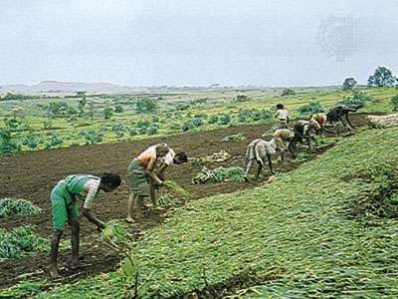
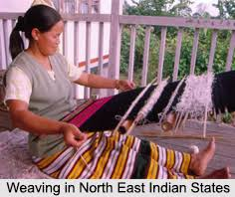
MAIN OCCUPATION FARMING WEAVING
LIFE INTHE REGION

Slide 15
STATES | OCCUPATION | FRUITS | FESTIVALS/DANCE | TOURIST PLACES
ARUNACHAL PRADESH | WOOD CARVING,CARPET WEAVING.BAMBOO AND CANE PRODUCTS | ORCHARDS AND ORCHIDS | - | ITANAGAR.ZIRO AND TAWANG
NAGALAND | WOOD CARVING AND POTTERY | - | - | KOHIMA AND DIMAPUR
MANIPUR | BAMBOO , CANE AND LEATHER | LYCHEE,CHESTNUT,WALNUT AND PAPAYA. | MANIPURI DANCE | IMPHAL AND UKHRUL
MIZORAM | ROSE CLTIVATION.SILKWORMS | - | CHAPCHUR KUT FESTIVAL | -
TRIPURA | HANDICRAFTS | - | - | AGARTALA AND UNAKOTI
MEGHALAYA | - | - | STRAWBERRY FESTIVAL | SHILLONG AND CHERRAPUNJI

